Slide 1
World Suicide Data
Project Team #7
Mujgan Guner, Ahmed Lotfy, Shanker Nair
June 25, 2020

Slide 2
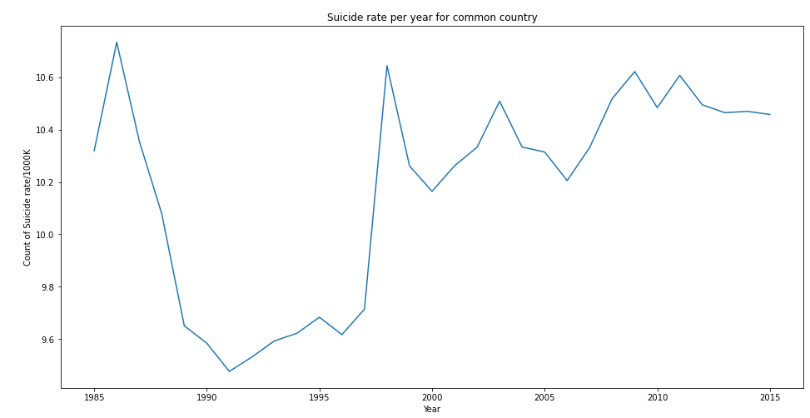

Slide 3
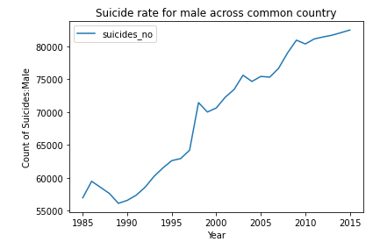
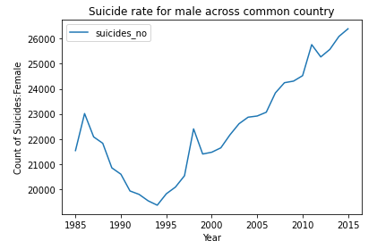
Gender make common scale

Slide 4
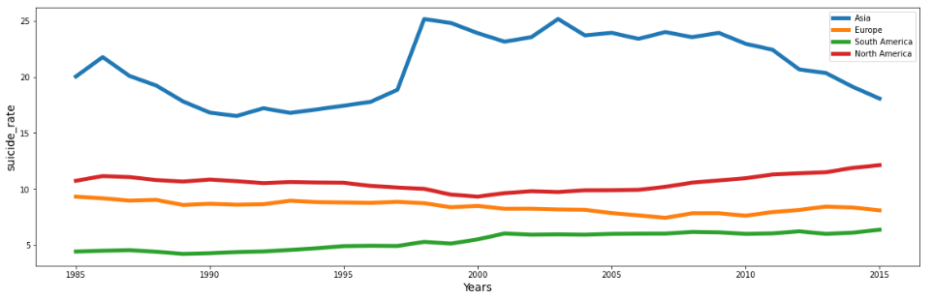

Slide 5
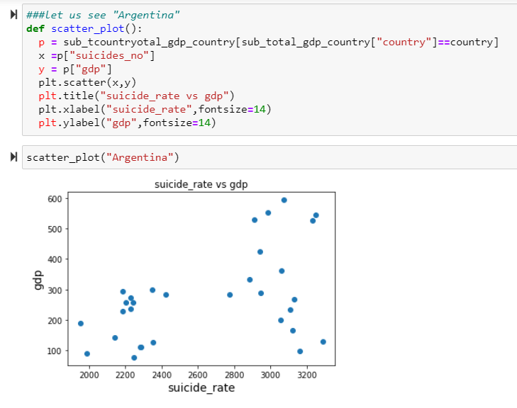
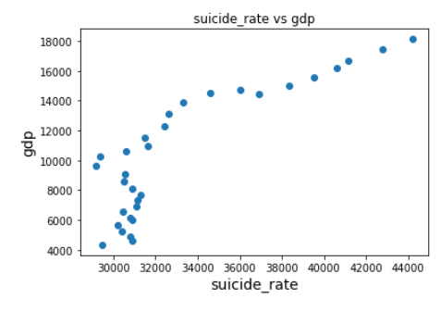

Slide 6
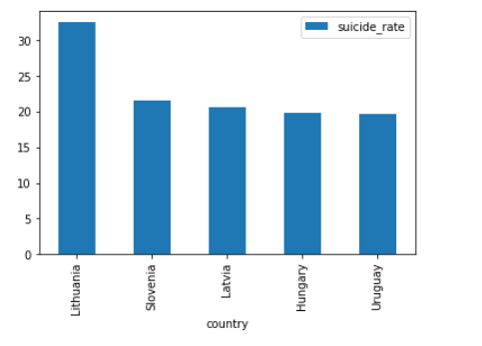

Slide 7
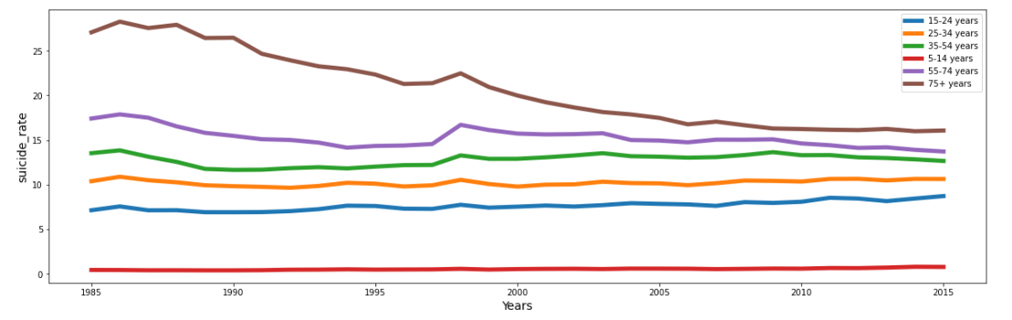

Slide 8
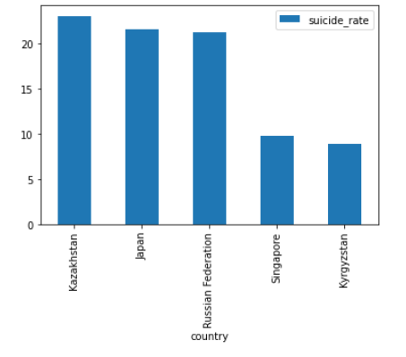

Slide 9
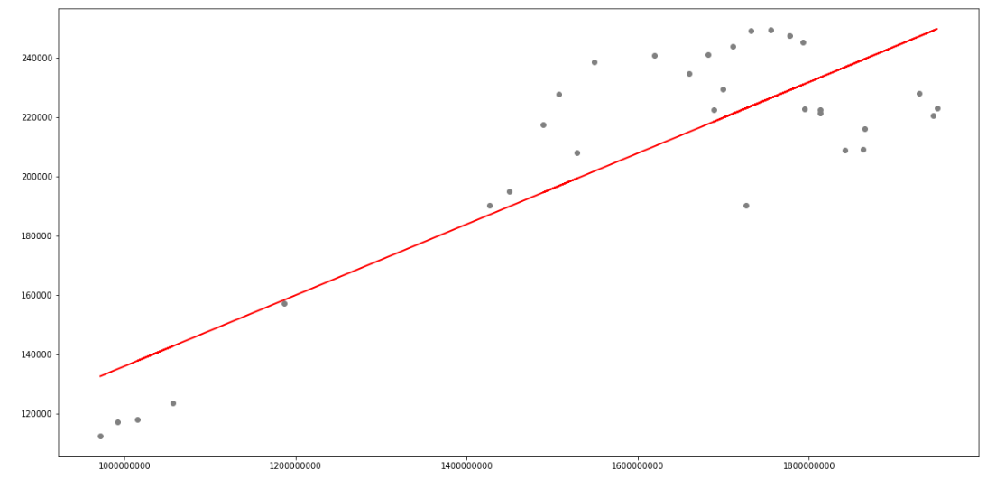
Suicide by population

Slide 10
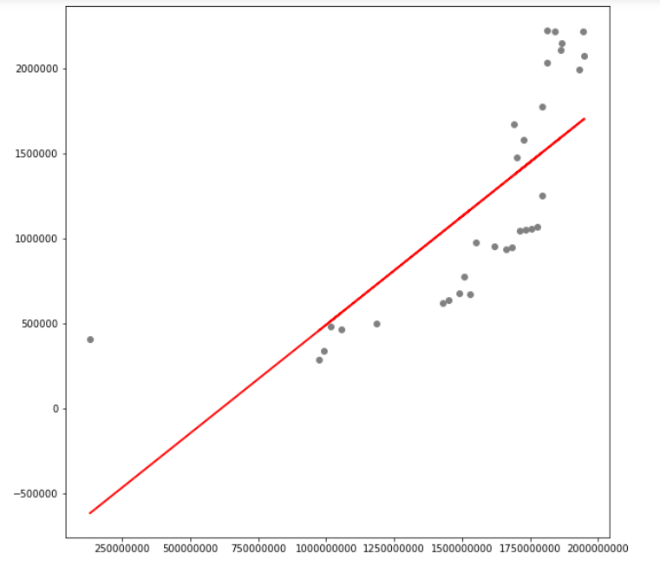
Suicide by GDP

Slide 12
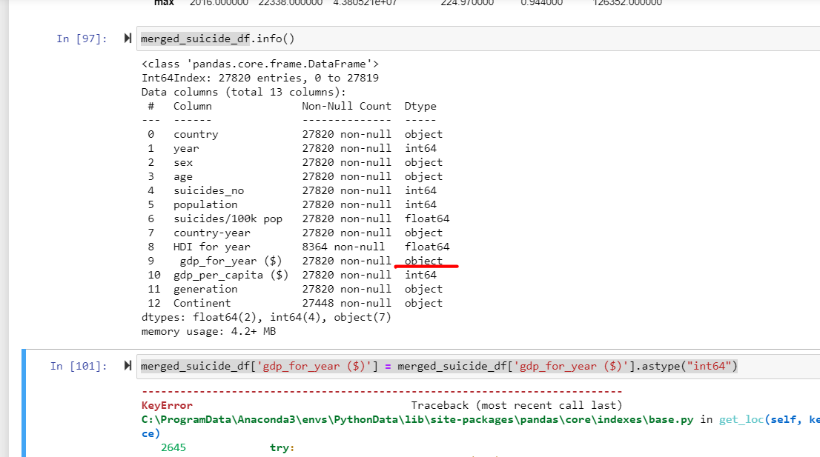
Gdp for eyar seems to be a string

Slide 13
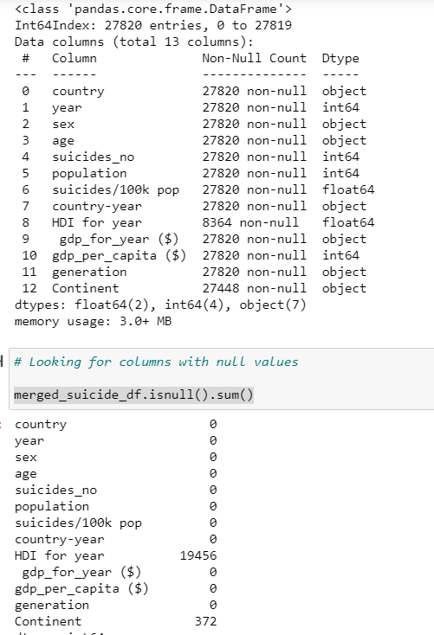
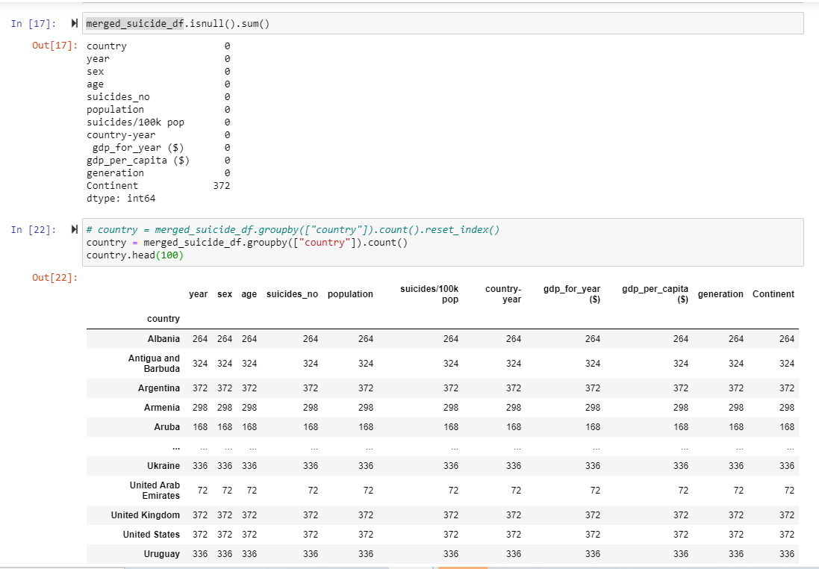
Gdp for year seems to be a string

Slide 14
NEW

Slide 15
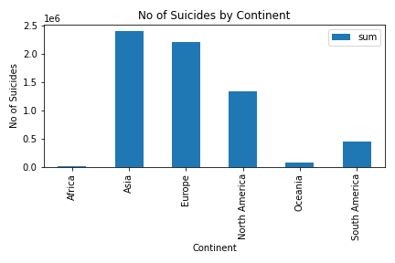
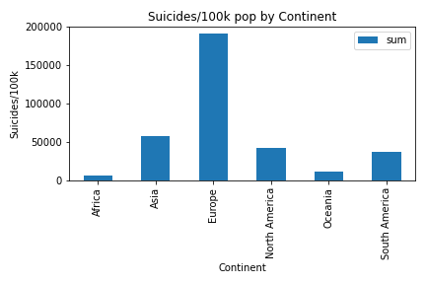
Suicide Number (Importance of normalization)

Slide 16
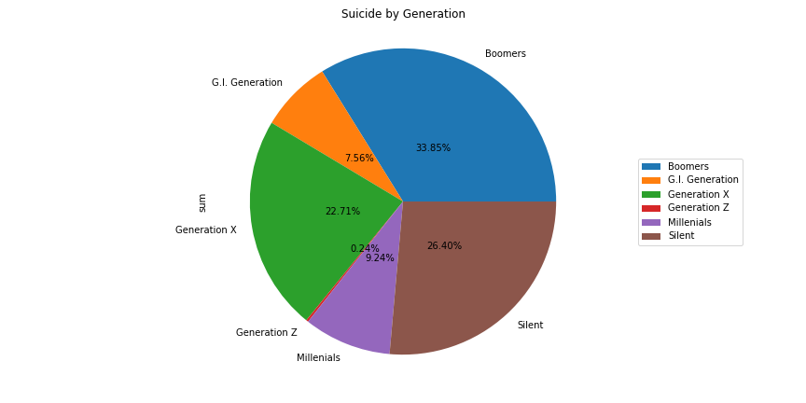
generation | age
Boomers | 25-34 years | 1154
 | 35-54 years | 3030
 | 55-74 years | 806
G.I. Generation | 55-74 years | 630
 | 75+ years | 2114
Generation X | 15-24 years | 2114
 | 25-34 years | 2682
 | 35-54 years | 982
 | 5-14 years | 630
Generation Z | 5-14 years | 1470
Millenials | 15-24 years | 2528
 | 25-34 years | 806
 | 5-14 years | 2510
Silent | 35-54 years | 630
 | 55-74 years | 3206
 | 75+ years | 2528

Slide 17
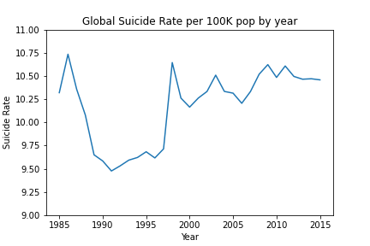

Slide 18
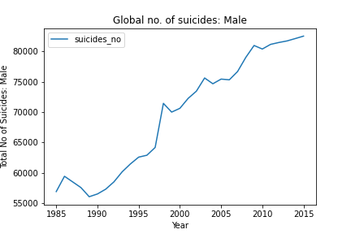
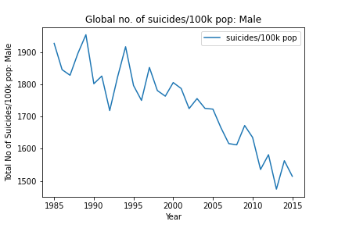
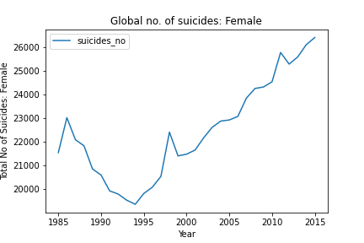
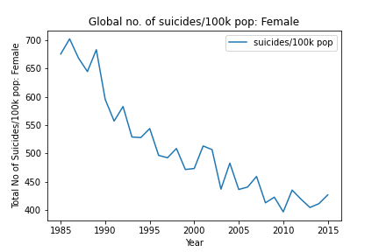
# Suicide number has only gone by by 35,000 from 1985 to 2016; however population has gone up by 300 million.
That explains why the suicide rate is going down with time

Slide 19
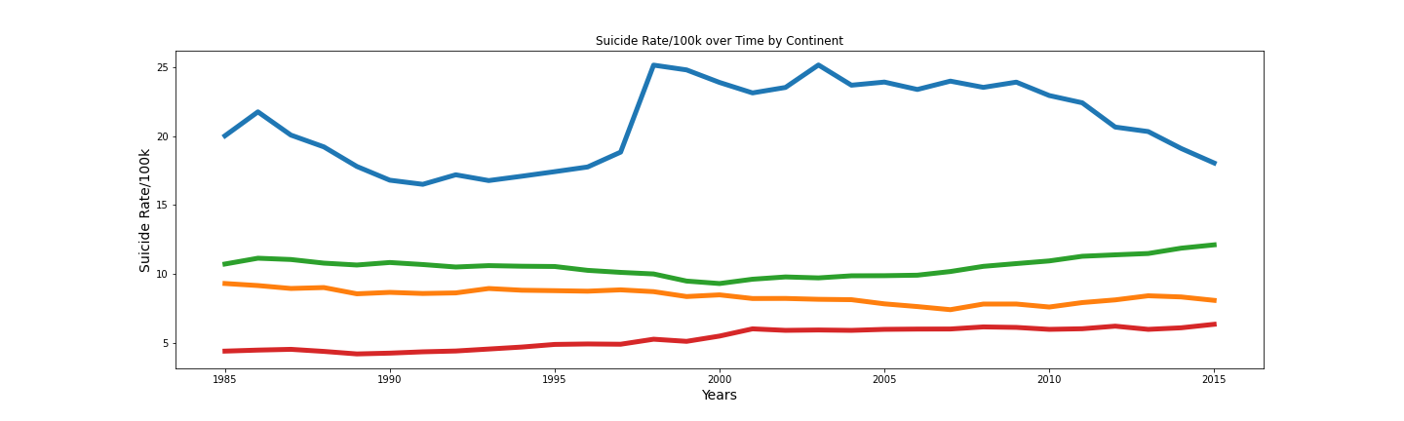

Slide 20
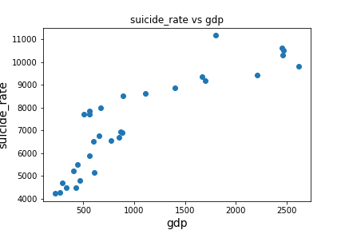
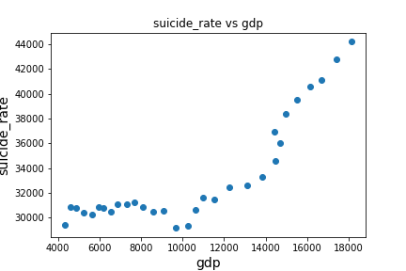
Brazil
USA

Slide 21
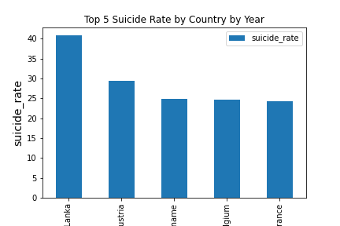
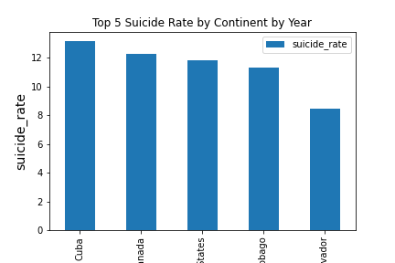
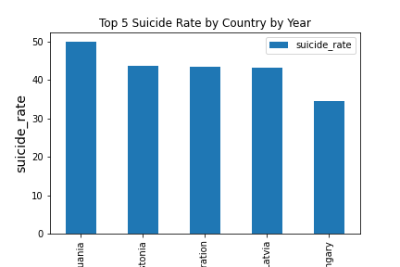
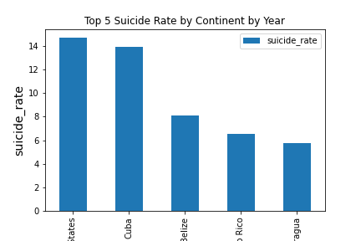
Top 5 countries by Year
1985
2005
1995
2015

Slide 22
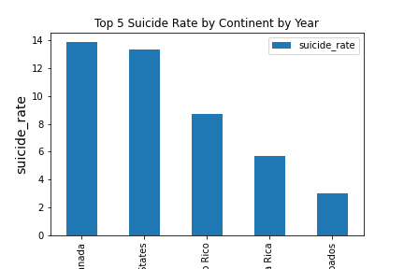
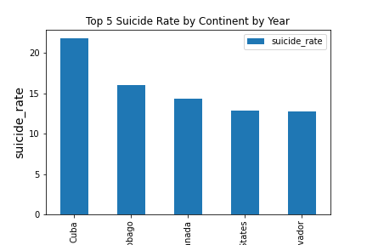
Top 5 countries by Continent/Year
1985
2005
1995
2015

Slide 23
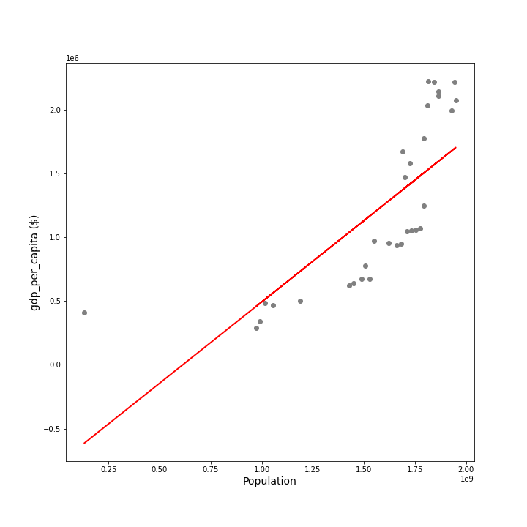
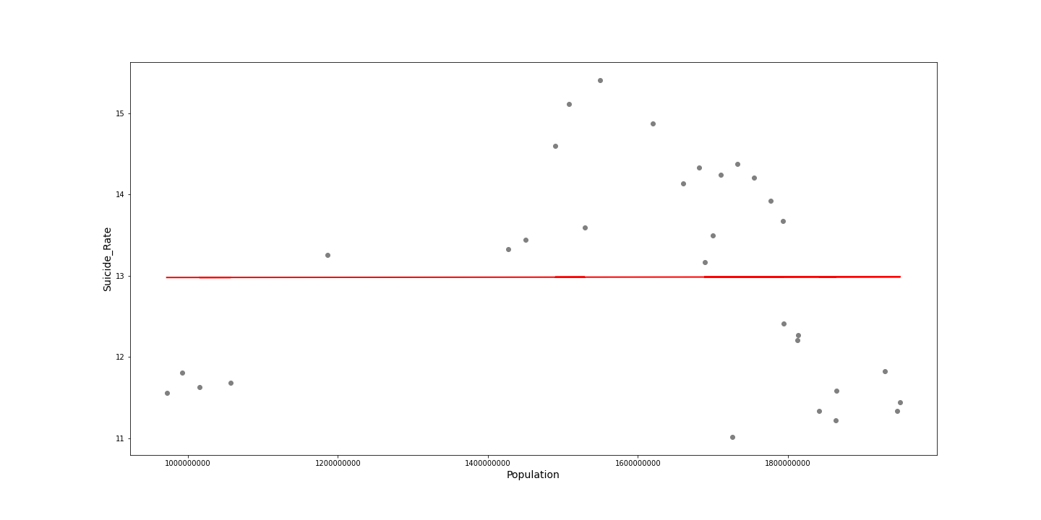

Slide 25
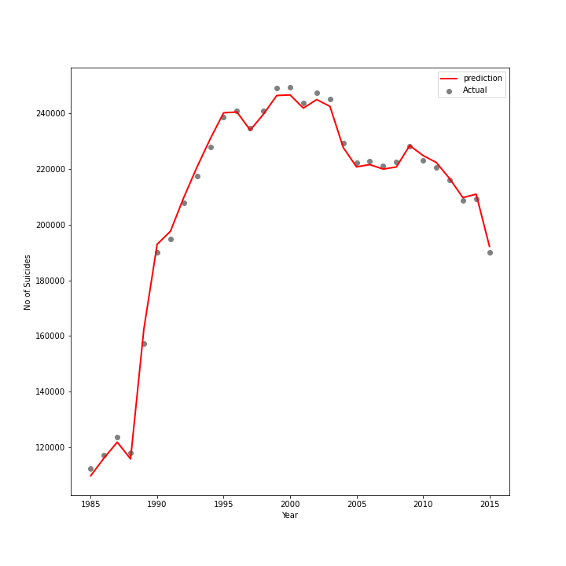
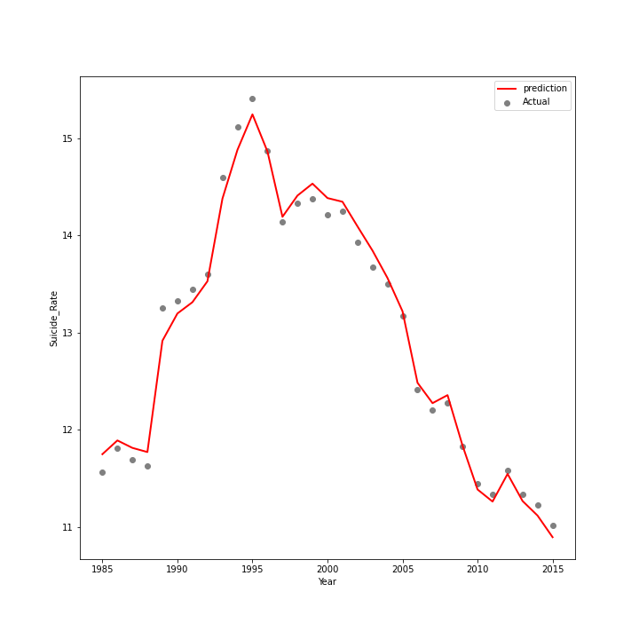
Multi variate regression Model
R2 =
R2 =

Slide 26
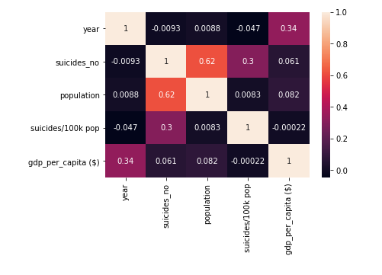

Slide 27
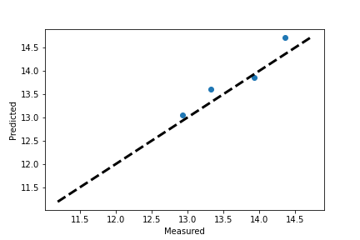
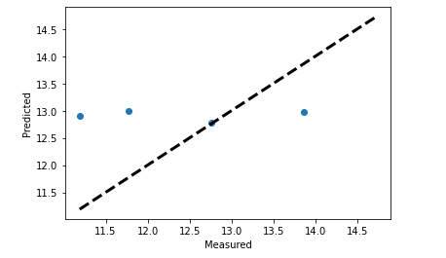
Multi variate regression Model
Italy
United States
R2 =
R2 =
RMSE
RMSE

